Slide 1



Online Value Added Course on Machine Learning, Deep Learning and Neural Networks
Day 8
Conducted by
Mr. Anupam Borthakur
Prime Minister’s Research Fellows (PMRF)
Centre of Excellence in Artificial Intelligence
Indian Institute Of Technology, Kharagpur
Department of Electrical and Electronics Engg.
Sagi Rama Krishnam Raju Engineering College (A), Bhimavaram

Slide 2

Indian Institute Of Technology Kharagpur | Centre of Excellence in Artificial Intelligence
Agenda
Recap of Supervised Learning
Introduction to Support Vector Machine (SVM)
Code implementation of that

Slide 3

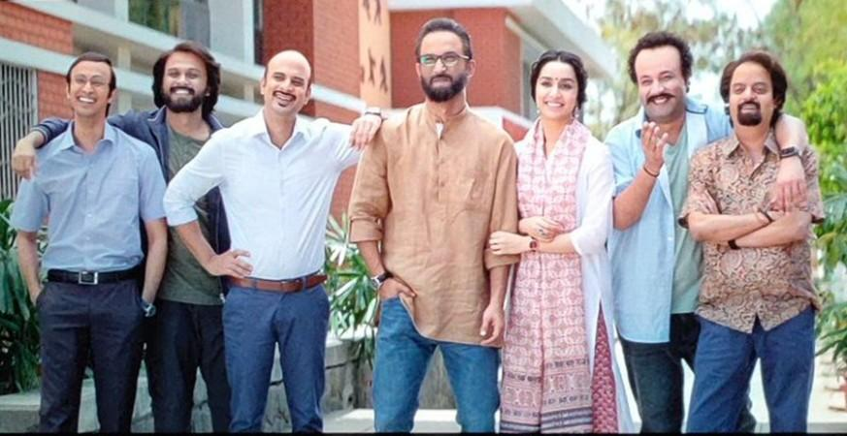
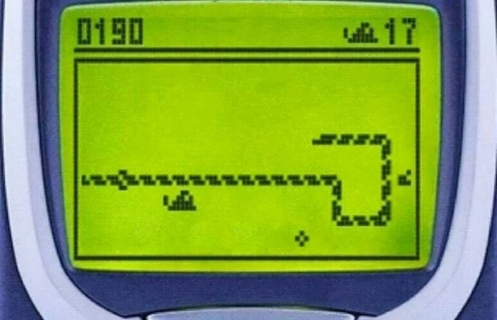

Indian Institute Of Technology Kharagpur | Centre of Excellence in Artificial Intelligence
Types of Machine Learning
Supervised Learning
Un-supervised Learning
Reinforcement Learning
https://in.pinterest.com/pin/257690409914685423/
https://stock.adobe.com/in/images/teacher-pulling-her-student-ear/164847519

Slide 4


Indian Institute Of Technology Kharagpur | Centre of Excellence in Artificial Intelligence
Supervised
Unsupervised
Age
Class
Age
14
T
14
24
A
Teenager (T)
Adult (A)
24
Find patterns
17
T
17
Groups
Clusters
30
A
30
Decision Surface
New: 15

Slide 5
Indian Institute Of Technology Kharagpur | Centre of Excellence in Artificial Intelligence
Simple Structure of a Database
No Class is present
Supervised
Unsupervised
Class
Samples
Samples
Attributes/Dimension
Attributes/Dimension
Database
Database

Slide 6
Indian Institute Of Technology Kharagpur | Centre of Excellence in Artificial Intelligence
Supervised
Types of Supervised Learning
Age
Class
14
T
Supervised Learning
24
A
17
T
30
A
Classification
Regression
Decision Surface

Slide 7
Indian Institute Of Technology Kharagpur | Centre of Excellence in Artificial Intelligence
Types of Supervised Learning
Supervised Learning
Age
Class
14
T
24
A
17
T
30
A
Classification
Regression
Output having labels(discrete value)
output having continuous value.
T
A
Classification

Slide 8
Indian Institute Of Technology Kharagpur | Centre of Excellence in Artificial Intelligence
Simple Training Pipeline of Machine Learning
Unknown Dataset
Dataset
Algorithm
Model
Prediction

Slide 9
Indian Institute Of Technology Kharagpur | Centre of Excellence in Artificial Intelligence
Introduction to Support Vector Machine (SVM)
1D to 2D
Decision Surface/ Hyperplane
Linearly Separable
Margin
Support Vectors
Functional Margin
Non-linearly Separable

Slide 10
Indian Institute Of Technology Kharagpur | Centre of Excellence in Artificial Intelligence
1D to 2D
1D
2D

Slide 11
Indian Institute Of Technology Kharagpur | Centre of Excellence in Artificial Intelligence
But the point is more close to B
Decision Surface
Close to Class B
But the point is more close to A
Close to Class A
New point
Middle

Slide 12
Indian Institute Of Technology Kharagpur | Centre of Excellence in Artificial Intelligence
maximum
Support Vectors
Margin
How many decision surface there could be?
Which decision surface to choose?
→ Infinite?
Minimum Distance of a training instance from the Decision surface

Slide 13
Indian Institute Of Technology Kharagpur | Centre of Excellence in Artificial Intelligence
maximum
Margin: Minimum Distance of a training instance from the Decision surface
Choose that Decision Surface for which the Margin width is maximum
Number of support vectors should be extremely small
Minimum two support vectors should be there
Support Vectors
Larger functional Margin more confidence in predicting
Margin
Minimum Distance of a training instance from the Decision surface

Slide 14

Indian Institute Of Technology Kharagpur | Centre of Excellence in Artificial Intelligence
Which decision surface to choose?
Decision 1
Decision 3
Decision 2

Slide 15
Indian Institute Of Technology Kharagpur | Centre of Excellence in Artificial Intelligence
Reason which decision surface is best
Decision 1
Decision 3
Decision 2
Choose that Decision Surface for which the Margin width is maximum

Slide 16
Indian Institute Of Technology Kharagpur | Centre of Excellence in Artificial Intelligence
Coding Tutorial

Slide 17
Indian Institute Of Technology Kharagpur | Centre of Excellence in Artificial Intelligence
Difference between Linearly Separable and Non- Separable
Non- Separable
Linearly Separable

Slide 18


Thank You
For your Attention!
Any Questions?

